Slide 1
AMBA BUS
Dept. of CSE
ASE-CBE

Slide 2
BUS
Bus is the mechanism by which CPU communicates with memory and IO devices.
It is not just a collection of wires. In fact, bus defines the protocol for communication.
Bus defines the corresponding transport mechanism between the CPU and memory and IO devices.

Slide 3
BUS
Bus - a shared communication link, because there a many devices which can actually sit on the bus.
A single set of wires - used to connect multiple subsystems.
Bus is also fundamental tool for composing large and complex systems

Slide 4
What defines Bus
Transaction Protocol
Timing and Signaling Specification
Bunch of Wires
Electrical Specifications
Physical mechanical characteristics - Connectors

Slide 5

Generic Bus Structure
Address Bus:
Data Bus:
Control Bus:
Status Bus:

Slide 6
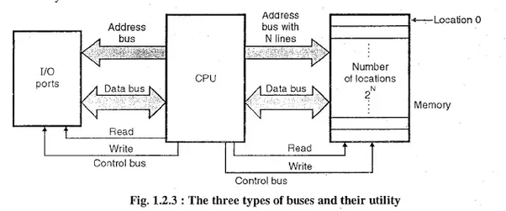

Slide 7
Bus Characteristics
Bus signals are usually tri stated
Tristate : Low State
High State
Tri-State ( High impedance state – electrically isolated but physically connected)
So, if a device would like to disconnect itself from the bus, it would drive its interface lines to tri state high impedance state. So, effectively it gets disconnected from the bus. So, all these devices are really sharing the common set of signal lines.

Slide 8
Bus Characteristics
Address and Data lines may be multiplexed.
Every device on the bus must be able to drive the maximum bus load. Because maximum bus load would determine what are the maximum number of device that you can actually put on the bus.
Bus may include a clock signal. Timing is relative to clock.

Slide 9
What is the major difference between Control lines and Signal lines ???
Control Signal === CPU ➔ Peripherals
Status Signal === Peripherals ➔ CPU
Can we club together Address and Data lines ?
Hint: AD0-AD7
Additional line needed ALE
Adv: Instead of 16 (A0-A7 and D0-D7) pins or lines we need only 8+1 (AD0-AD7 and ALE)
Also recall about parallel and serial Communication Hard Disk : P ATA and S ATA cables

Slide 10
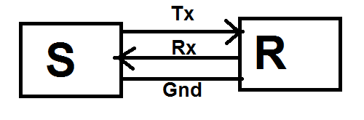
Asynchronous Communication Protocol:
Example : UART – Universal Asynchronous Receiver Cum Transmitter
No Common Clock and so Framing is Required
Start D0 D1 D2 D3 D4 D5 D6 D7 STOP

Slide 11
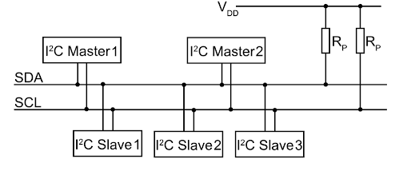
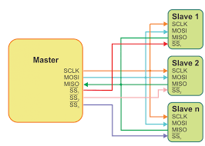
Synchronous Communication Protocol (Common Clock)
Example: I2C
SPI –Serial Peripheral Interface

Slide 12
ARM Bus

Slide 13
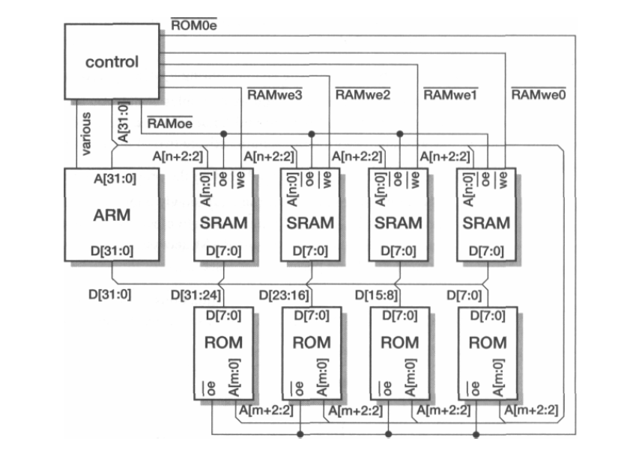
Basic ARM Memory System

Slide 14
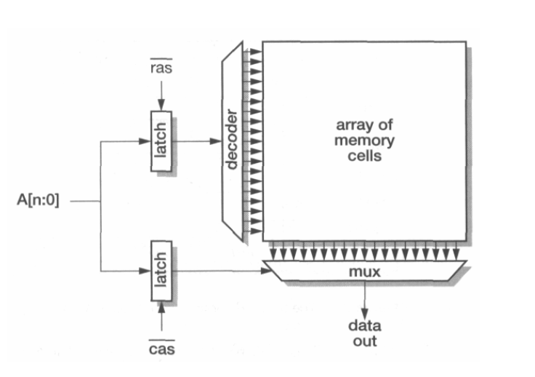
DRAM Memory Organisation

Slide 15
DRAM Memory Organisation

Slide 16
AMBA Advanced Microcontroller Bus Architecture

Slide 17
ARM processor cores have bus interfaces that are optimized for high-speed cache interfacing. Where a core is used, with or without a cache, as a component on a complex system chip, some interfacing is required to allow the ARM to communicate with other on-chip macrocells.
ARM Limited specified the Advanced Microcontroller Bus Architecture, AMBA, to standardize the on-chip connection of different macrocells.

Slide 18
Three buses are defined in AMBA Specification:
The Advanced High-performance Bus (AHB)
The Advanced System Bus (ASB)
The Advanced Peripheral Bus (APB)

Slide 19
AHB is used to connect high-performance system modules. It supports burst mode data transfers and split transactions, and all timing is reference to a single clock edge.
ASB is used to connect high-performance system modules. It supports burst mode data transfers.
APB offers a simpler interface for low-performance peripherals.

Slide 20
A typical AMBA-based microcontroller will incorporate either an AHB or an ASB together with an APB as illustrated in Figure The ASB is the older form of system bus, with AHB being introduced later to improve support for higher performance, synthesis and timing Verification.
The APB is generally used as a local secondary bus which appears as a single slave module on the AHB or ASB.

Slide 21
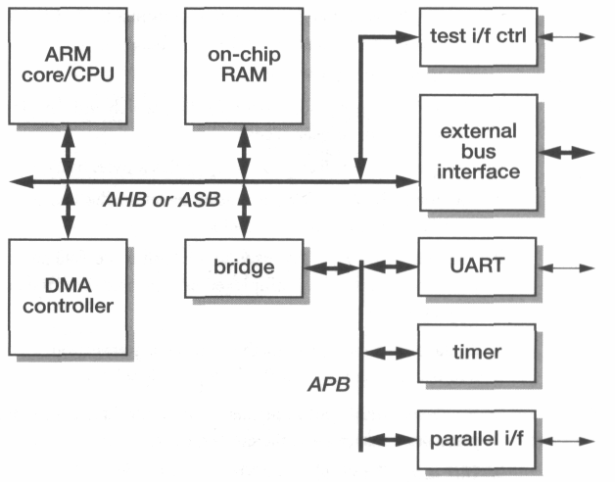
Typical AMBA based systems

Slide 22
Bus Arbitration
A bus transaction is initiated by a bus master which requests access from a central arbiter.
The arbiter decides priorities when there are conflicting requests, and its design is a system specific issue.
The ASB only specifies the protocol which must be followed:
The master, x, issues a request (AREQx) to the central arbiter.
When the bus is available, the arbiter issues a grant (AGNTx) to the master.
(The arbitration must take account of the bus lock signal (BLOK) to ensure that atomic bus transactions are not violated.)

Slide 23
Bus Transfer
When a master has been granted access to the bus, it issues address and control information to indicate the type of the transfer and the slave device which should respond. The following signal is used to define the transaction timing:
The bus clock, BCLK. This will usually be the same as mclk, the ARM processor clock.
The bus master which holds the grant then proceeds with the bus transaction using the following signals:

Slide 24
Bus transaction, BTRAN[1:0], indicates whether the next bus cycle will be address-only, sequential or non-sequential. It is enabled by the grant signal and is ahead of the bus cycle to which it refers.
The address bus, BA[31:OJ.
Bus transfer direction, BWRITE.
Bus protection signals, BPROT[1:0], which indicate instruction or data fetches and supervisor or user access.
The transfer size, BSIZE[1:0], specifies a byte, half-word or word transfer.
Bus lock, BLOK, allows a master to retain the bus to complete an atomic read / modify-write transaction.
The data bus, BD[31:0], used to transmit write data and to receive read data. In an implementation with multiplexed address and data, the address is also transmitted down this bus.

Slide 25
A slave unit may process the requested transaction immediately, accepting write data or issuing read data on ED[31:0], or signal one of the following responses:
• Bus wait, BWAIT, allows a slave module to insert wait states when it cannot complete the transaction in the current cycle.
• Bus last, BLAST, allows a slave to terminate a sequential burst to force the bus master to issue a new bus transaction request to continue.
• Bus error, BERROR, indicates a transaction that cannot be completed. If the master is a processor it should abort the transfer.

Slide 26
Bus Reset:
The ASB supports a number of independent on-chip modules, many of which may be able to drive the data bus (and some control lines). Provided all the modules obey the bus protocols, there will only be one module driving any bus line at any time.
If two or more modules power-up trying to drive bus lines in opposite directions, the output drive clashes may cause power supply crow-bar problems which may prevent the chip from powering up properly at all. Correct ASB power-up is ensured by imposing an asynchronous reset mode that forces all drivers off the bus independently of the clock.

Slide 27
Advanced Peripheral Bus – APB
It is a simple, static bus which operates as a stub on an ASB to offer a minimalist interface to very simple peripheral macrocells.
The bus includes address PADDR[n:0] and read and write data PRDATA[m:0] and PWDATA[m:0], where m is 7, 15 or 31), a read/write direction indicator (PWRITE), individual peripheral select strobes (PSELx) and a
peripheral timing strobe (PENABLE). APB transfers are timed to PCLK, and all APB devices are reset with PRESETn.

Slide 28
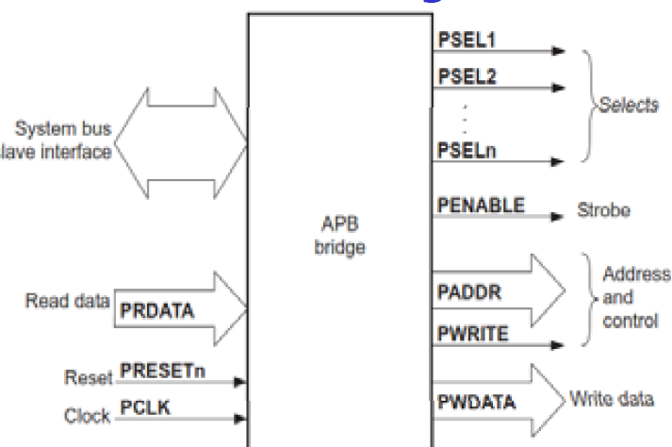

Slide 29
Advanced High Performance Bus - AHB
The AHB is intended to replace the ASB in very high performance systems. The following features differentiate the AHB from the ASB:
• It supports split transactions, where a slave with a long response latency can free up the bus for other transfers while it prepares its data for transmission.
• It uses a single clock edge to control all of its operations.
• It uses a centrally multiplexed bus scheme rather than a bidirectional bus with tristate drivers.
• It supports wider data bus configurations of 64 or 128 bits.

Slide 30
Ref: ARM System-on-Chip Architecture by Steve Furber 2nd Edition
Thank You

